Slide 1
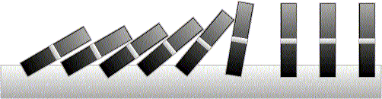
Mathematical Induction I

Slide 2
This Lecture
We have already discussed different proof techniques.
This time we will focus on probably the most important one
– mathematical induction.
This lecture’s plan is to go through the following:
The idea of mathematical induction
Basic induction proofs (e.g. equality, inequality, property,etc)
An interesting example
A paradox

Slide 3
Why Induction
We need to prove many statements that are true for a set (e.g., all integers):
  For every positive integer n:
    n! >= n^n
    n^3 – n is divisible by 3
    A set with n elements has 2^n subsets
    The sum of first n positive integers is n(n+1)/2
    etc.

Slide 4
Induction: Main Idea
Proofs using mathematical induction have two parts.
  First, they show that the statement holds for the positive integer 1.
  Second, they show that if the statement holds for a positive integer then it must also hold for the next larger integer.
Formally this is based on the rule of inference:
  if P (1) and ∀k(P (k) → P (k + 1)) are true for the domain of positive integers, then ∀n P(n) is true.

Slide 5
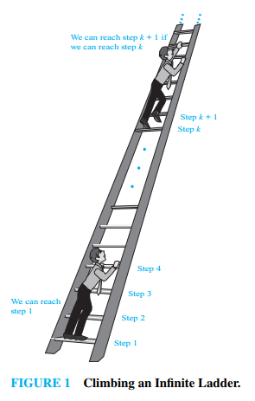
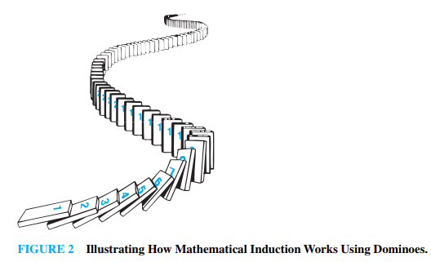
Main Idea of Induction

Slide 6
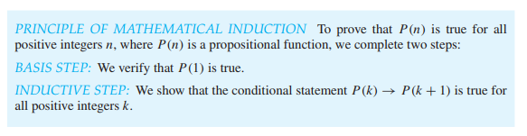
Principle of MI

Slide 7
Principle of MI
If P(k) is true then P(k+1) is true

Slide 8
Principle of MI
Induction Hypothesis
If P(k) is true then P(k+1) is true

Slide 9
Principle of MI
Induction Hypothesis
If P(k) is true then P(k+1) is true

Slide 10
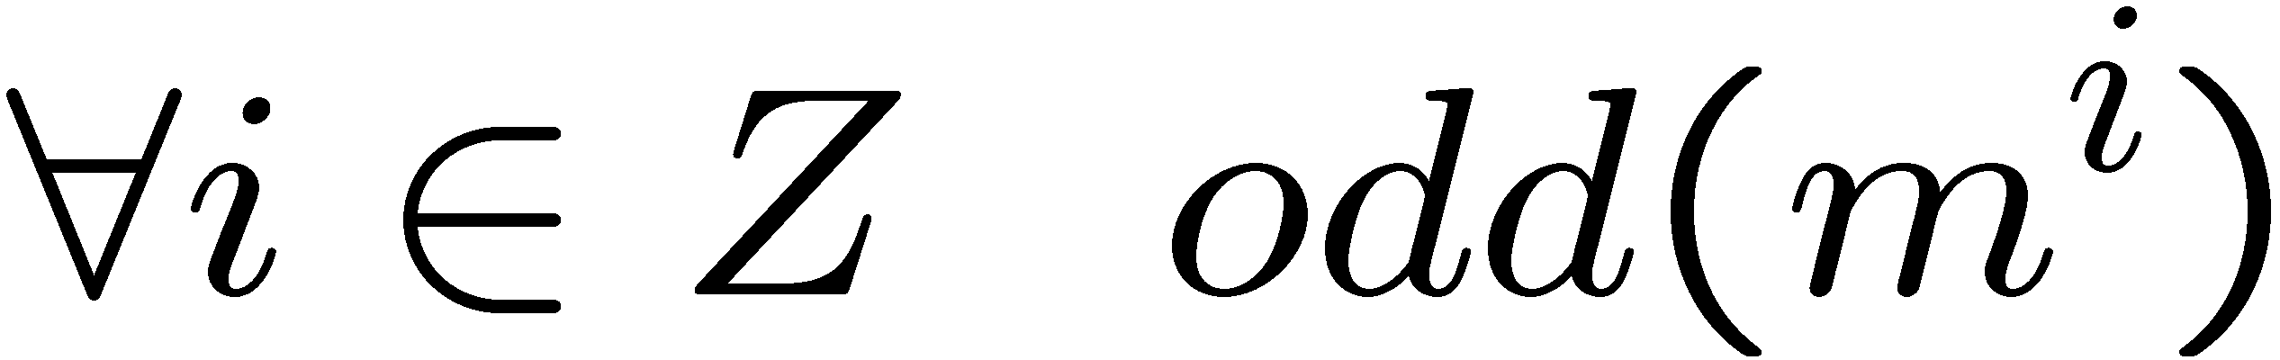
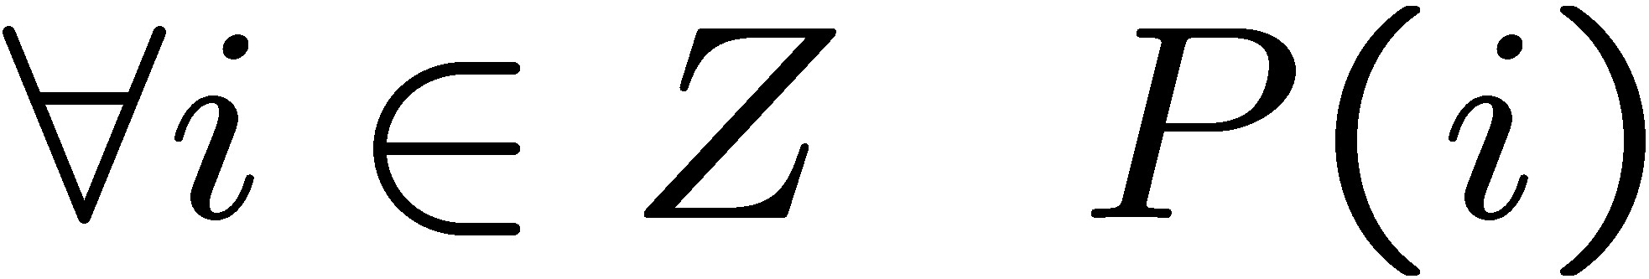
Odd Powers Are Odd: Induction Idea
Fact: If m is odd and n is odd, then nm is odd.
Proposition: for an odd number m, m^{i} is odd for all non-negative integer i.
Let P(i) be the proposition that m^{i} is odd.
Idea of induction.
P(1) is true by definition.
P(2) is true by P(1) and the fact.
P(3) is true by P(2) and the fact.
P(i+1) is true by P(i) and the fact.
So P(i) is true for all i.

Slide 11
Divisibility by a Prime: Induction Idea
Theorem. Any integer n > 1 is divisible by a prime number.
Let n be an integer.
If n is a prime number, then we are done.
Otherwise, n = ab, both are smaller than n.
If a or b is a prime number, then we are done.
Otherwise, a = cd, both are smaller than a.
If c or d is a prime number, then we are done.
Otherwise, repeat this argument, since the numbers are
getting smaller and smaller, this will eventually stop and
we have found a prime factor of n.
Idea of induction.

Slide 12
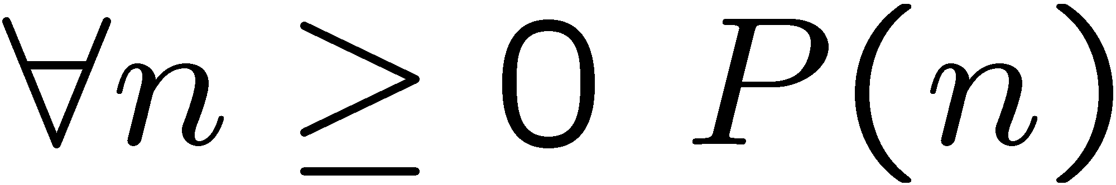
Idea of Induction
Objective: Prove
This is to prove
The idea of induction is to first prove P(0) unconditionally,
then use P(0) to prove P(1)
then use P(1) to prove P(2)
and repeat this to infinity…

Slide 13
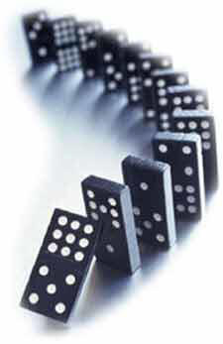
The Induction Rule
0 and (from n to n +1),
proves 0, 1, 2, 3,….
P (0), ∀n∈Z P (n)P (n+1)
∀m∈Z. P (m)
Much easier to prove with P(n) as an assumption.
Very easy to prove
valid rule
The point is to use the knowledge on smaller problems
to solve bigger problems.

Slide 14
Good and Bad of MI
Good
Bad
It can prove a conjecture once it has been made (and is true)
Often simple
Cannot find/propose a new theorem
Do not provide any insight as to why the theorem is true

Slide 15
This Lecture
The idea of mathematical induction
Basic induction proofs (e.g. equality, inequality, property,etc)
An interesting example
A paradox

Slide 16
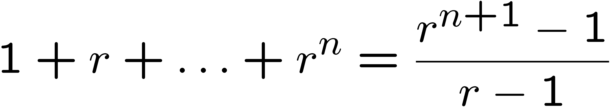
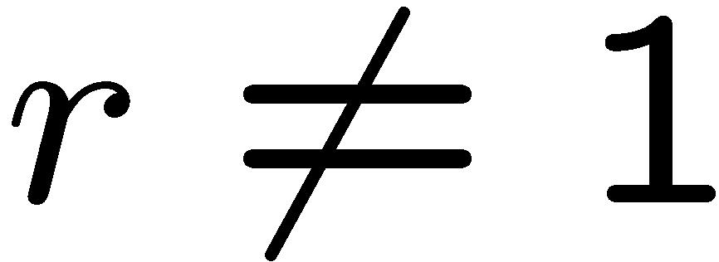
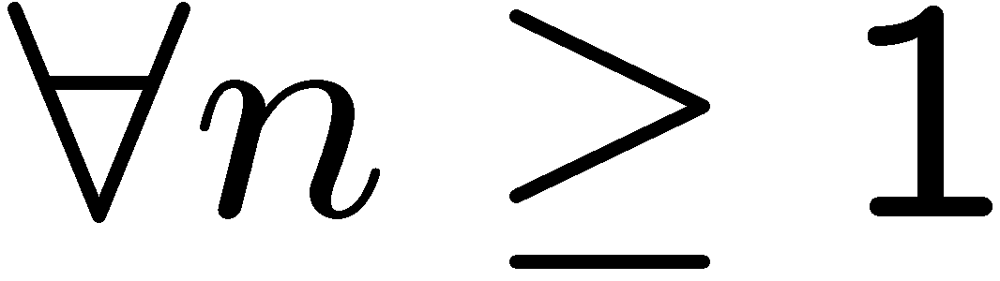
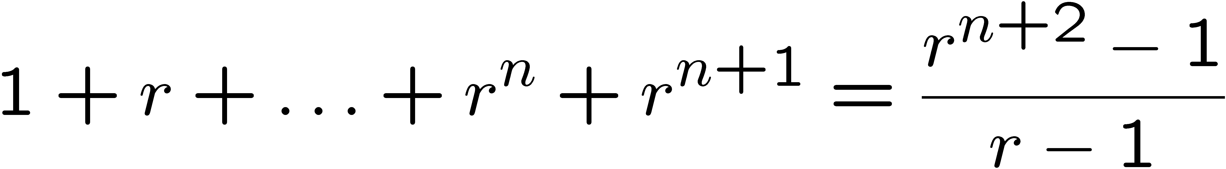
Proving an Equality
Let P(n) be the induction hypothesis that the statement is true for n.
Base case: P(1) is true
because both LHS and RHS equal to 1
Induction step: assume P(n) is true, prove P(n+1) is true.
That is, assuming:
Want to prove:
This is much easier to prove than proving it directly,
because we already know the sum of the first n terms!

Slide 17
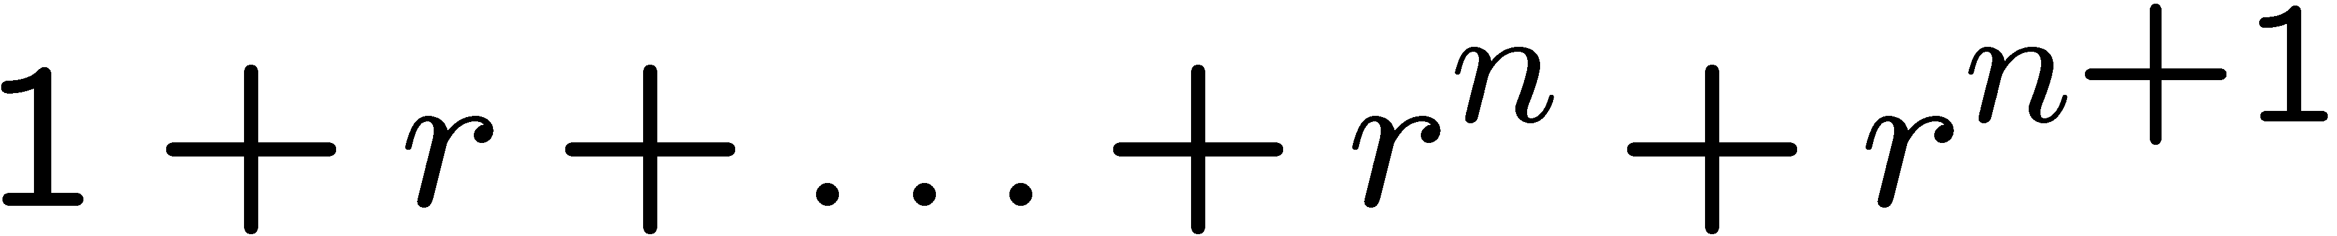
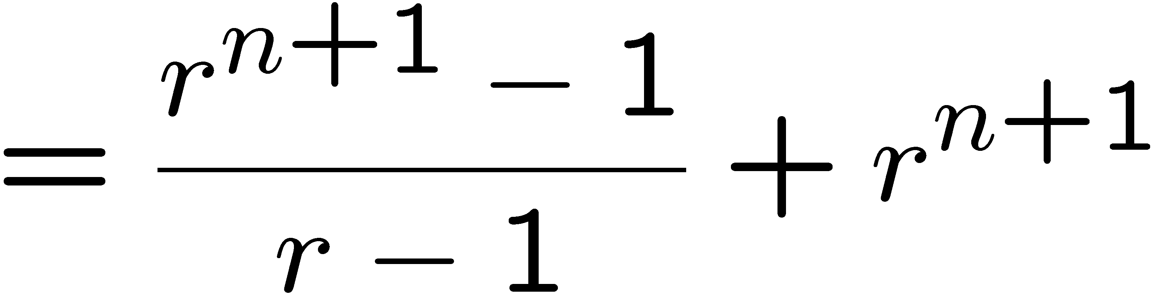
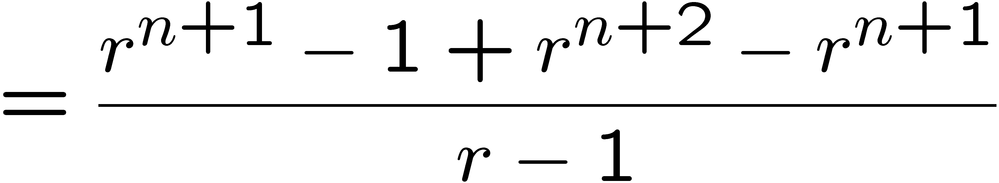
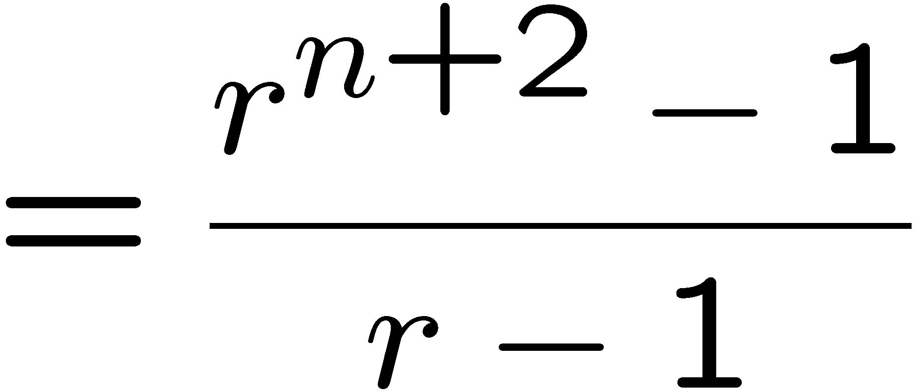
Proving an Equality
Let P(n) be the induction hypothesis that the statement is true for n.
Base case: P(1) is true
because both LHS and RHS equal to 1
Induction step: assume P(n) is true, prove P(n+1) is true.
by induction

Slide 18
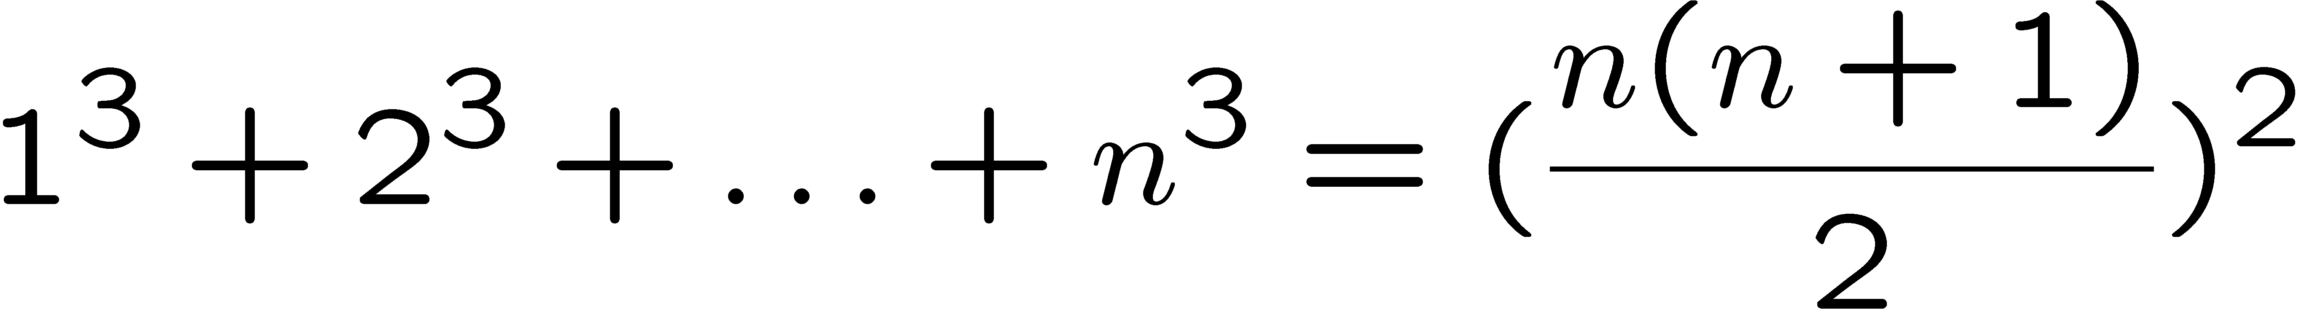
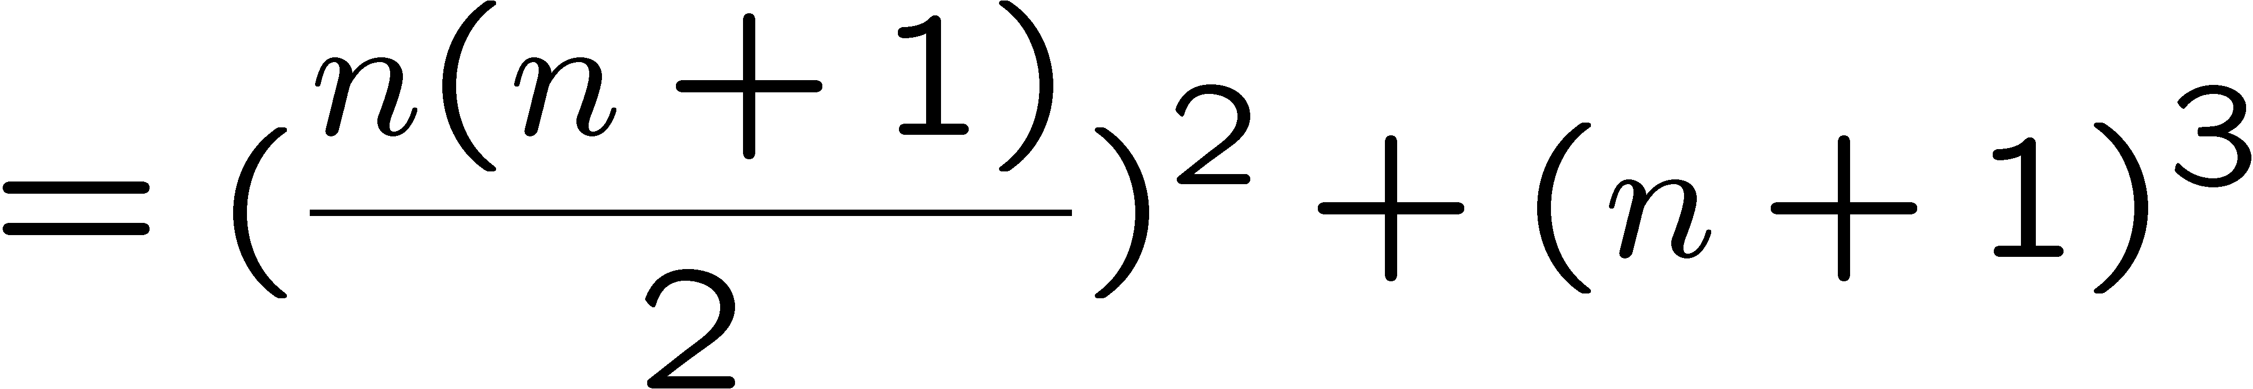
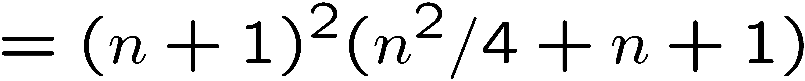
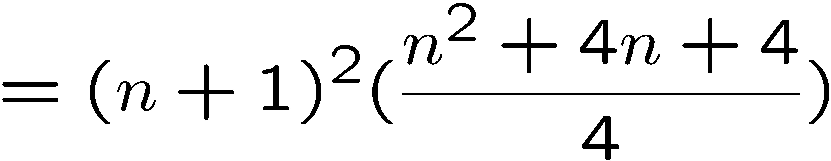
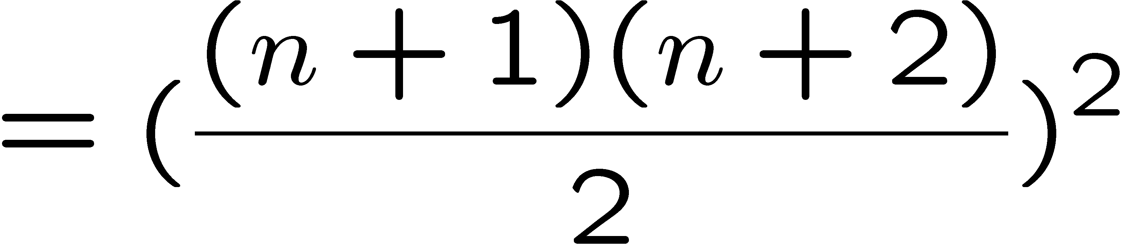
Proving an Equality
Let P(n) be the induction hypothesis that the statement is true for n.
Base case: P(1) is true
Induction step: assume P(n) is true, prove P(n+1) is true.
by induction

Slide 19
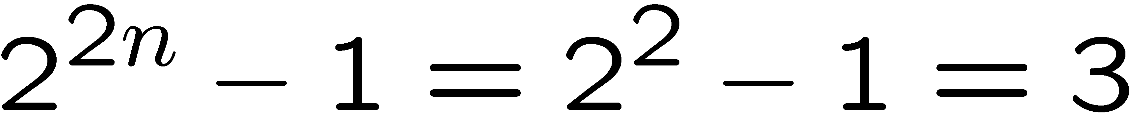
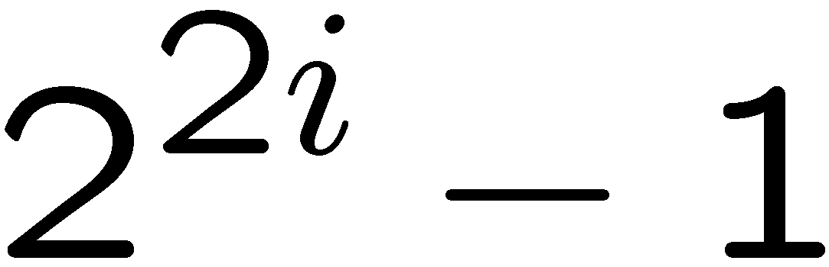
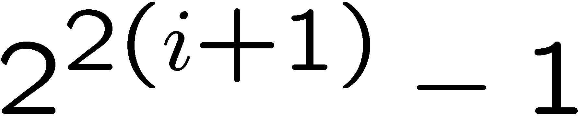
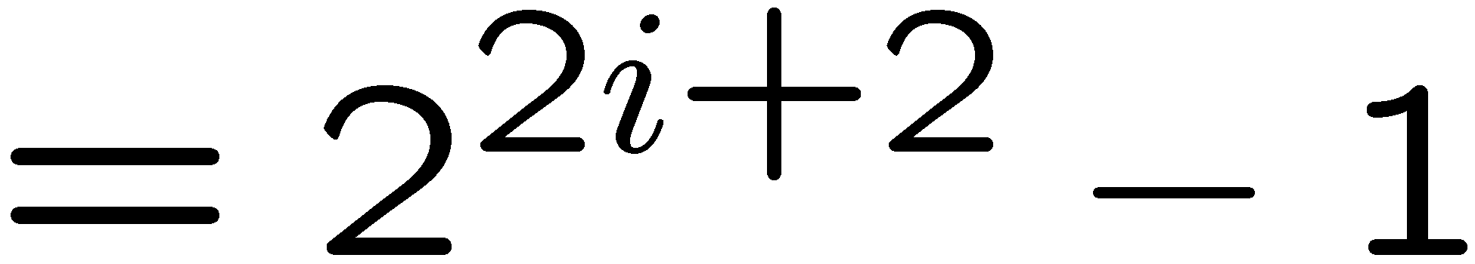
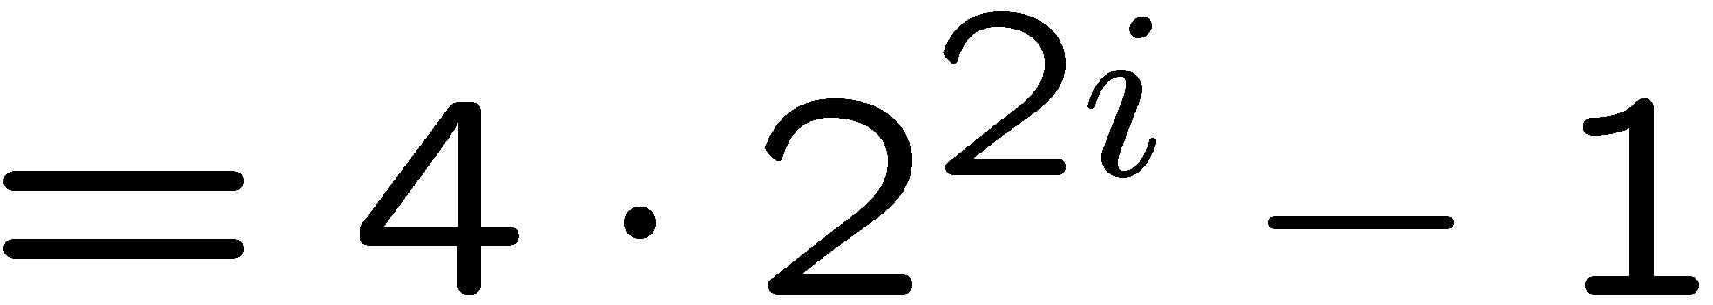
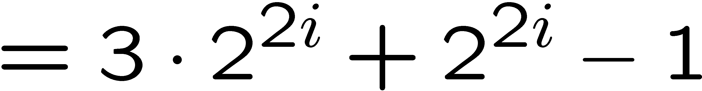
Proving a Property
Base Case (n = 1):
Induction Step: Assume P(i) for some i ≥ 1 and prove P(i + 1):
Assume
is divisible by 3, prove
is divisible by 3.
Divisible by 3
Divisible by 3 by induction

Slide 20
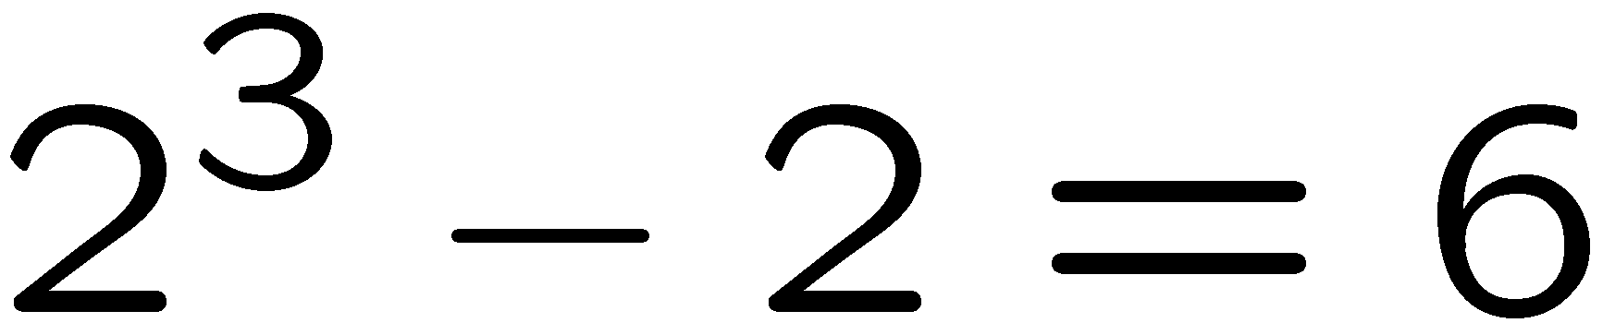
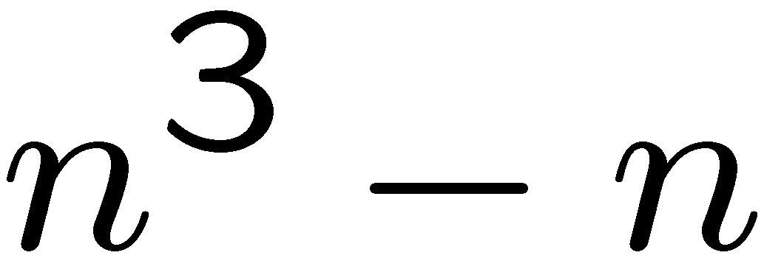
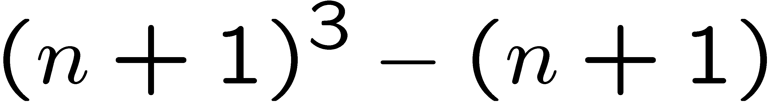
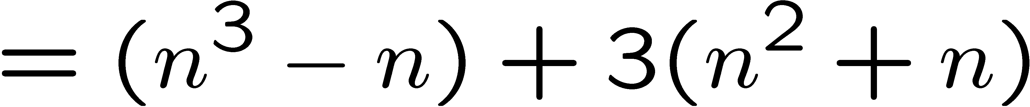
Proving a Property
Base Case (n = 2):
Induction Step: Assume P(i) for some i ≥ 2 and prove P(i + 1):
Assume
is divisible by 6
Prove
is divisible by 6.
HOW?
Divisible by 6
by induction
Divisible by 2
by case analysis

Slide 21
n^2 + n is divisible by 2 (Case Analysis)
Say n is odd:
  Recall: for an odd number m, m^{i} is odd for all non-negative integer i.
  So, n^2 is odd; n is also odd
  n^2 + n is sum of two odd numbers => even
Say n is even
  Easy…

Slide 22
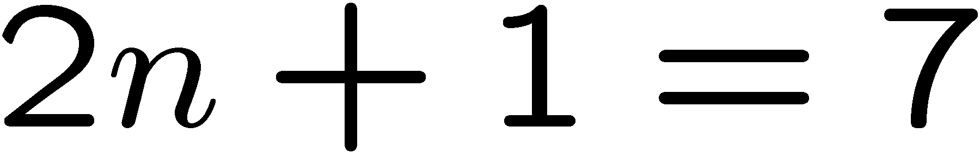
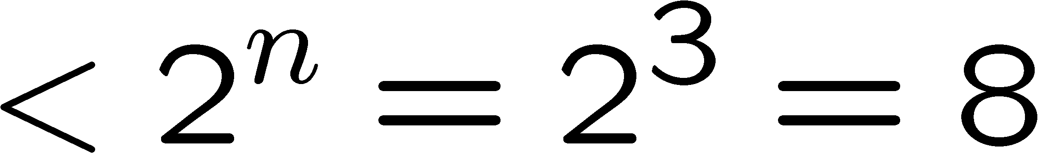
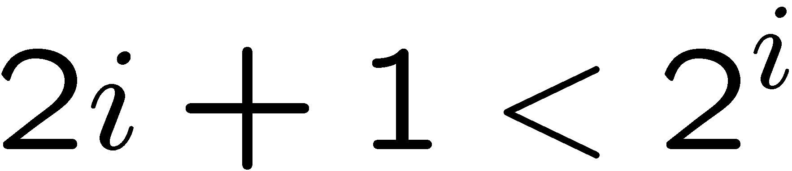
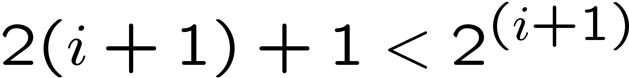
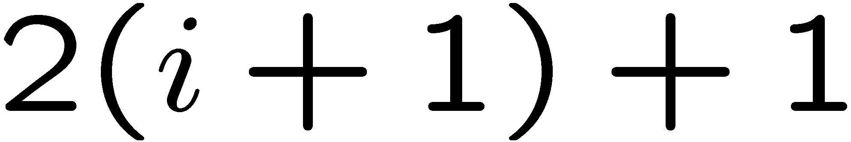
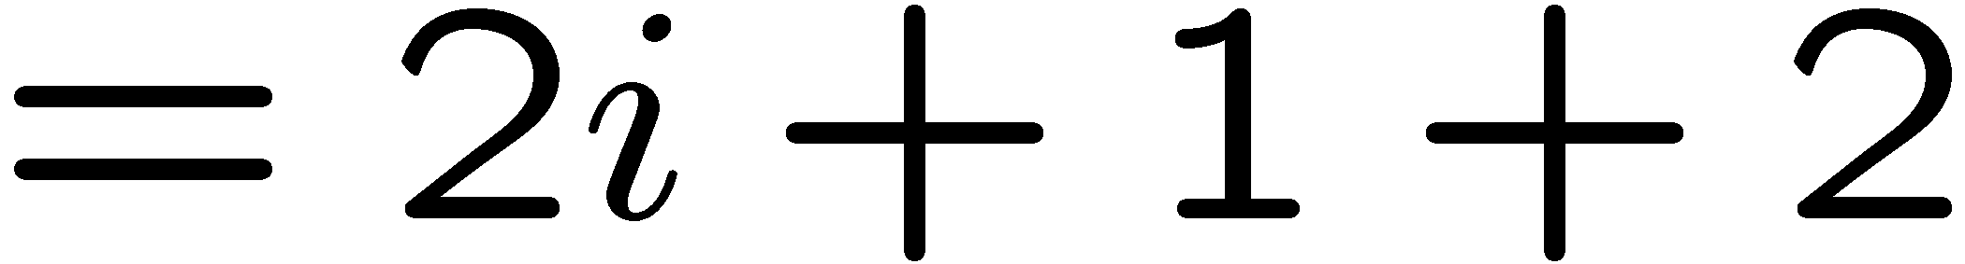
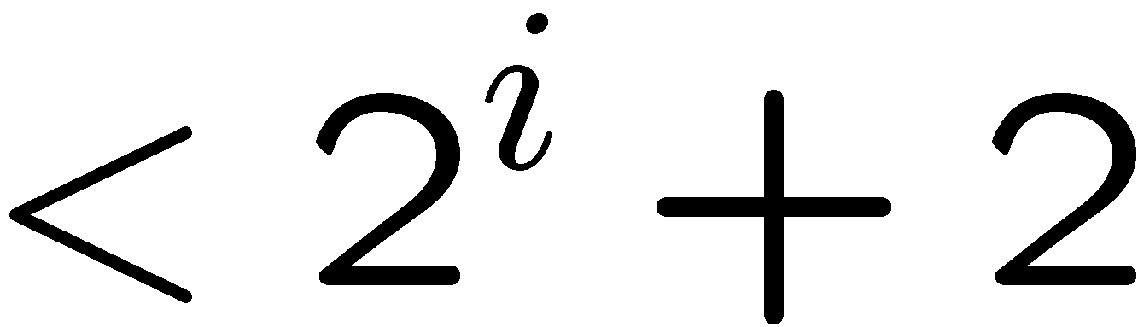
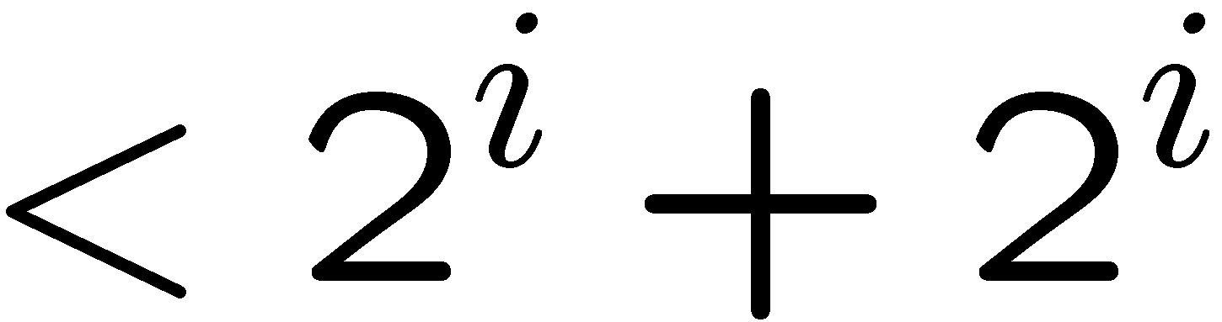
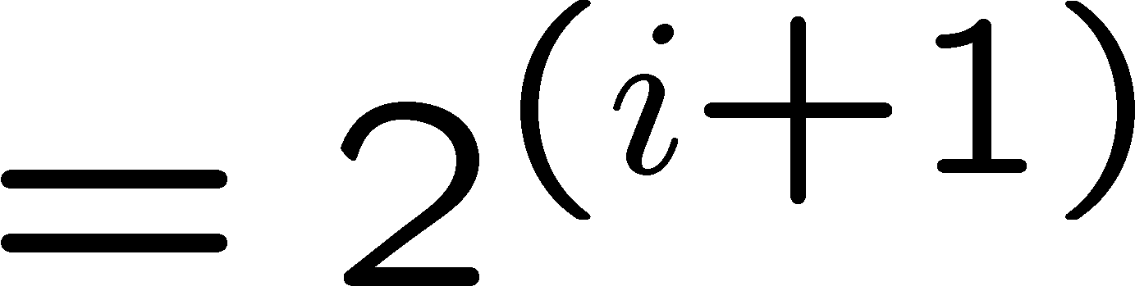
Proving an Inequality
Base Case (n = 3):
Induction Step: Assume P(i) for some i ≥ 3 and prove P(i + 1):
Assume
, prove
by induction
since i >= 3, we must have 2 < 2^i

Slide 23
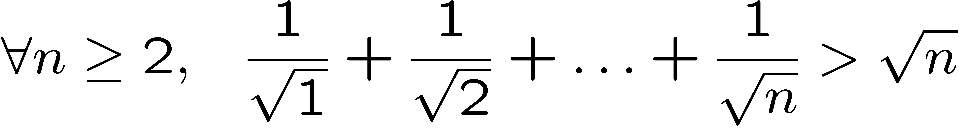
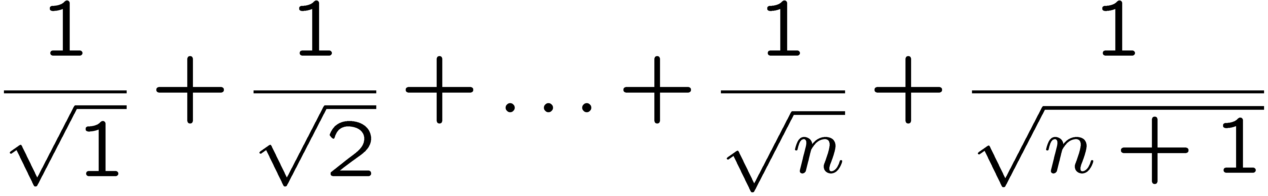
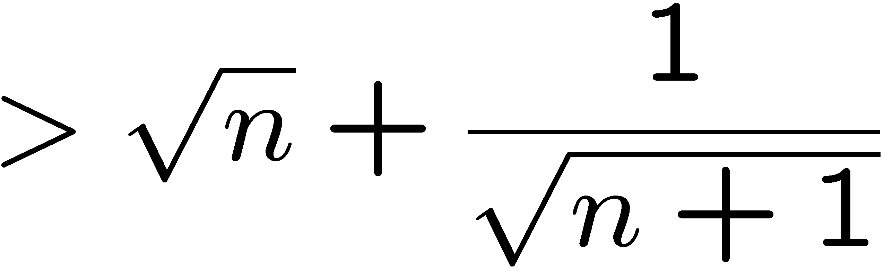
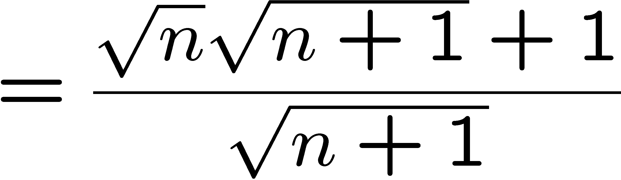
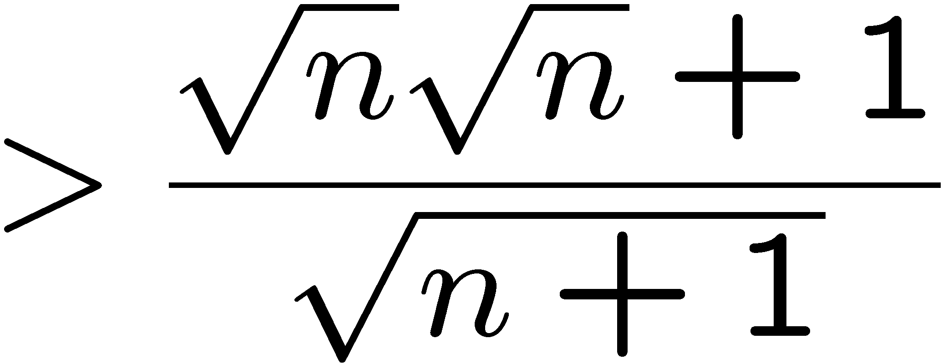
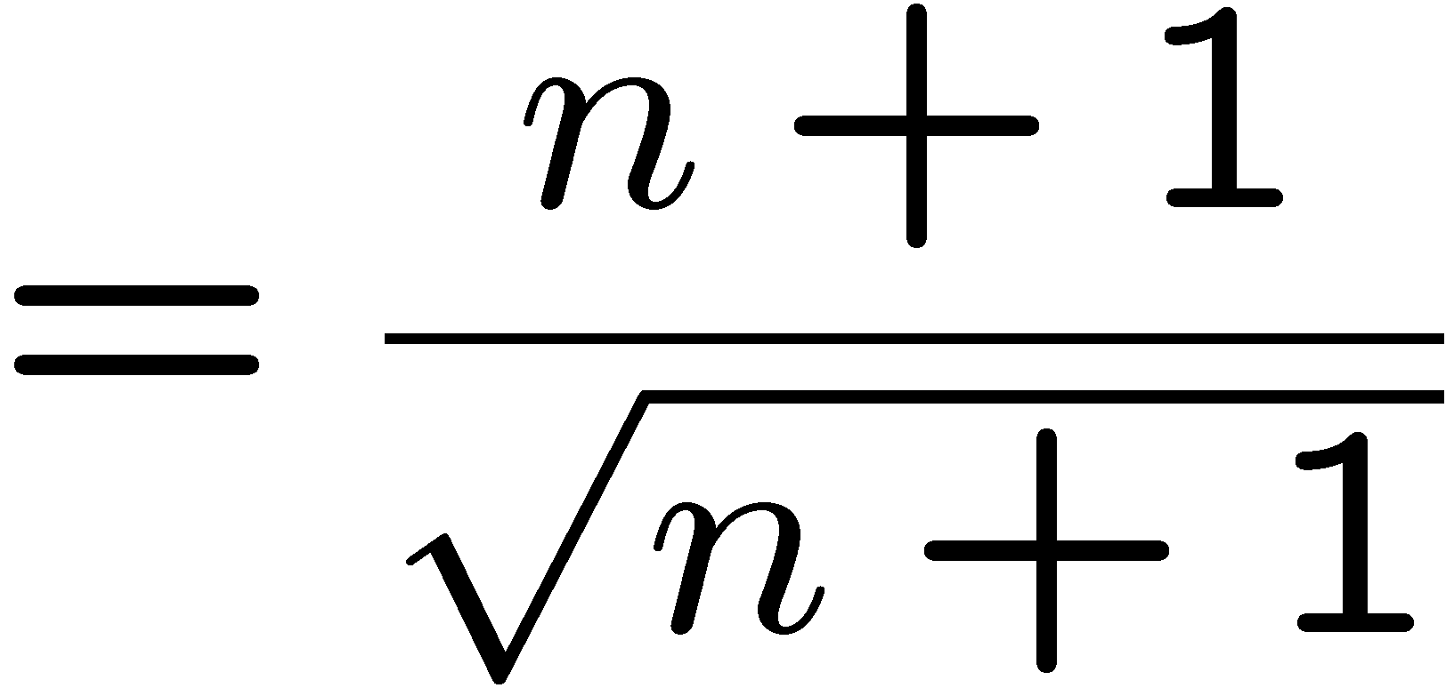

Proving an Inequality
Base Case (n = 2) is true [1/√1 + 1/√2 = 1.71 > 1.41 = √2]
Induction Step: Assume P(i) for some i ≥ 2 and prove P(i + 1):
by induction

Slide 24
This Lecture
The idea of mathematical induction
Basic induction proofs (e.g. equality, inequality, property,etc)
An interesting example
A paradox

Slide 25
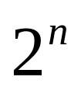
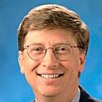
Puzzle
Goal: tile the squares, except one in the middle for Bill.

Slide 26

Puzzle
There are only trominos (L-shaped tiles) covering three squares:
For example, for 8 x 8 puzzle might tile for Bill this way:

Slide 27
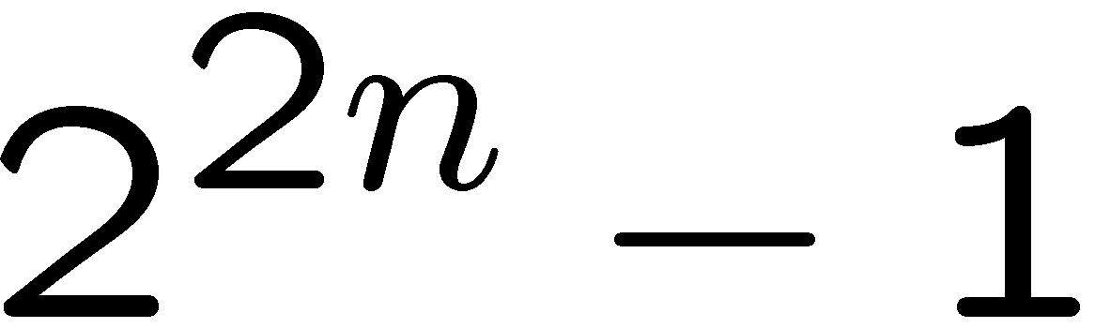
Puzzle
Theorem: For any 2^{n} x 2^{n} puzzle, there is a tiling with Bill in the middle.
Did you remember that we proved
is divisble by 3?
Proof: (by induction on n)
P(n) ::= can tile 2^{n} x 2^{n} with Bill in middle.
Base case: (n=0)
(no tiles needed)

Slide 28
Puzzle
Induction step: assume can tile 2^{n} x 2^{n},
prove can handle 2^{n+1} x 2^{n+1}.
Now what??
2
n
+
1

Slide 29
Puzzle
The new idea:
A stronger property
Prove that we can always find a tiling with Bill anywhere.
Theorem B: For any 2^{n} x 2^{n} plaza, there is a tiling with Bill anywhere.
Clearly Theorem B implies Theorem.
Theorem: For any 2^{n} x 2^{n} plaza, there is a tiling with Bill in the middle.

Slide 30
Puzzle
Theorem B: For any 2^{n} x 2^{n} plaza, there is a tiling with Bill anywhere.
Proof: (by induction on n)
P(n) ::= can tile 2^{n} x 2^{n} with Bill anywhere.
Base case: (n=0)
(no tiles needed)

Slide 31
Puzzle
Induction step:
Assume we can get Bill anywhere in 2^{n} x 2^{n}.
Prove we can get Bill anywhere in 2^{n+1} x 2^{n+1}.

Slide 32
Puzzle
Induction step:
Assume we can get Bill anywhere in 2^{n} x 2^{n}.
Prove we can get Bill anywhere in 2^{n+1} x 2^{n+1}.

Slide 33
Puzzle
Method: Now group the squares together,
and fill the center with a tile.
Done!

Slide 34
Some Remarks
Note 1: It may help to choose a stronger hypothesis
than the desired result (e.g. “Bill in anywhere”).
Note 2: The induction proof of “Bill in corner” implicitly
defines a recursive procedure for finding corner tilings.

Slide 35
This Lecture
The idea of mathematical induction
Basic induction proofs (e.g. equality, inequality, property,etc)
An interesting example
A paradox

Slide 36

Paradox
Theorem: All horses have the same color.
Proof: (by induction on n)
Induction hypothesis:
P(n) ::= any set of n horses have the same color
Base case (n=0):
No horses so obviously true!
…

Slide 37
Paradox
(Inductive case)
Assume any n horses have the same color.
Prove that any n+1 horses have the same color.
…
n+1

Slide 38
Paradox
(Inductive case)
Assume any n horses have the same color.
Prove that any n+1 horses have the same color.
Second set of n horses have the same color
…
First set of n horses have the same color

Slide 39
Paradox
(Inductive case)
Assume any n horses have the same color.
Prove that any n+1 horses have the same color.
…
Therefore the set of n+1 have the same color!

Slide 40
Paradox
What is wrong?
n =1
Proof that P(n) → P(n+1)
is false if n = 1, because the two
horse groups do not overlap.
Second set of n=1 horses
First set of n=1 horses
(But proof works for all n ≠ 1)
The main problem is that you have assumed a overlap between any to sets;
This is NOT true

Slide 41
Quick Summary
You should understand the principle of mathematical induction well,
and do basic induction proofs like
  proving equality
  proving inequality
  proving property
Mathematical induction has a wide range of applications in computer science.
In the next lecture we will see more applications and more techniques.

